Slide 1
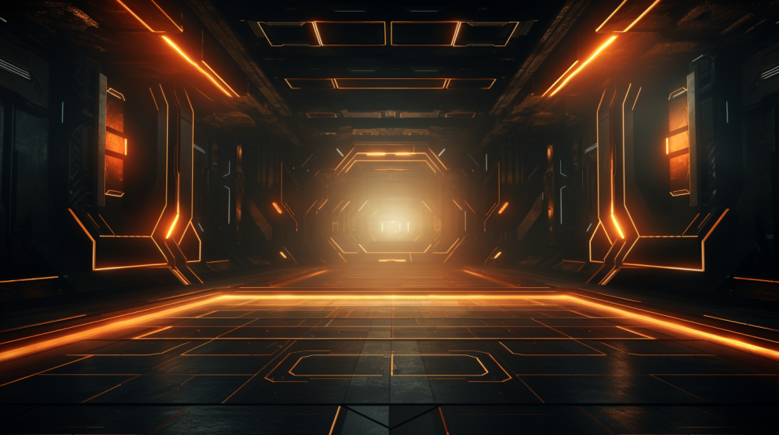
Harnessing the Power of AI

Slide 2
What is Generative AI?
Generative AI refers to a subset of AI models designed to create new data that resembles a given dataset. In essence, it generates ‘original’ content based on what it has been trained on.
It is capable of producing text, images, and even music
Works based on vast amounts of data
Can be applied across many sectors
Automates tasks

Slide 3
What Generative AI is not?
Generative AI is not completely autonomous.
It is not always accurate.
Is not a replacement for human expertise.
It is not content-aware

Slide 4
Some examples
Learning Intention and Success Criteria:
https://chat.openai.com/share/8f73f043-fc06-4d11-bae3-cfa7f9e36f66
Basic Lesson Plan and Blooket
https://chat.openai.com/share/bdf9df0b-c36f-430c-b5a2-0d0515b27fc0
Assignment Context
https://chat.openai.com/share/53dbcf7f-af57-4828-a706-a973c0c9ebae

Slide 5
Other AI Applications
Image Generators
MidJourney
Leonardo.ai
Slideshow Generators
Gamma
Tome
Podcast / Audio Generators
Descript

